Slide 1
Chapter 3 Software Requirement Analysis –PART 1
Determining System Requirements
System Process Requirements
System Data Requirements

Slide 2
Determining System Requirements

Slide 3
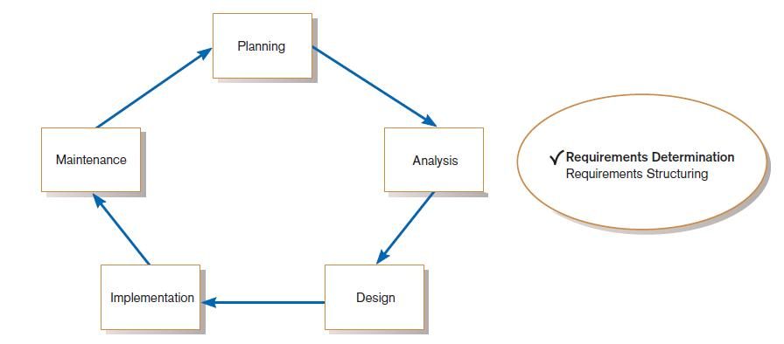
Performing Requirements Determination
FIGURE 1
Systems development life cycle with analysis phase highlighted

Slide 4
The Process of Determining Requirements
Good Systems Analyst Characteristics:
  Impertinence—question everything
  Impartiality—consider all issues to find the best organizational solution
  Relax constraints—assume anything is possible
  Attention to details—every fact must fit with every other fact
  Reframing—challenge yourself to new ways

Slide 5
Deliverables and Outcomes
Deliverables for Requirements Determination:
  From interviews and observations — interview transcripts, observation notes, meeting minutes
  From existing written documents — mission and strategy statements, business forms, procedure manuals, job descriptions, training manuals, system documentation, flowcharts
  From computerized sources — Joint Application Design session results, CASE repositories, reports from existing systems, displays and reports from system prototype

Slide 6
These deliverables contain the information to understand the following components of an organization:
• The business objectives that drive what and how work is done
• The information people need to do their jobs
• The data (definition, volume, size, etc.) handled within the organization to
support the jobs
• When, how, and by whom or what the data are moved, transformed, and stored
• The sequence and other dependencies among different data-handling activities
• The rules governing how data are handled and processed
• Policies and guidelines that describe the nature of the business and the market and environment in which it operates
• Key events affecting data values and when these events occur

Slide 7
The time required to collect and structure a great deal of information can be extensive and, because it involves so much human effort, quite expensive.
Too much analysis is not productive, and the term analysis paralysis has been coined to describe a systems development project that has become bogged down in an abundance of analysis work. Because of the dangers of excessive analysis, today’s systems analysts focus more on the system to be developed than on the current system.
  “Study the current system only to learn from its weaknesses. Your real job is to design the system that replaces it.”
Newer techniques have also been developed to keep requirements determination fast and flexible, including continual user involvement, usage-centered design, and the Planning Game from eXtreme Programming.

Slide 8
Methods for Determining System Requirements
Traditional Methods
Contemporary Methods
Radical Methods
Agile Methodologies

Slide 9
1- Traditional Methods for Determining Requirements
Core activity in systems analysis: Collecting information.
Initial focus: Understand existing information systems and identify areas for improvement.
Purpose: Learn how users want to enhance systems and organizational processes with new or updated systems.
Primary method: Talk to stakeholders — including users, managers, funders, etc.
Supplementary method: Gather existing documentation (e.g., system manuals, reports, procedures).

Slide 10
Traditional Methods of Collecting System Requirements
Individually interview people informed about the operation and issues of the current system and future systems needs
Interview groups of people with diverse needs to find synergies and contrasts among system requirements
Observe workers at selected times to see how data are handled and what information people need to do their jobs
Study business documents to discover reported issues, policies, rules, and directions as well as concrete examples of the use of data and information in the organization

Slide 11
1.1- Interviewing and Listening
Primary method for gathering information in systems projects.
Analysts interview people early in the project to understand:
  Their work processes
  The information they use
  Information processing needs
Other stakeholders (e.g., managers) are interviewed to explore:
  Organizational goals and direction
  Policies and expectations
  Nonroutine operational aspects
Interviewing reveals:
  Facts, opinions, and speculations
  Non-verbal cues: body language, emotions, preferences
  No single "best" way to conduct interviews — various effective methods exist depending on context.
Interview Guide is a document for developing, planning and conducting an interview.

Slide 12
Guidelines for Effective Interviewing
Plan the interview.
  Prepare interviewee: appointment, priming questions.
  Prepare agenda, checklist, questions.
Listen carefully and take notes (tape record if permitted).
Review notes within 48 hours.
Be neutral.
Seek diverse views.

Slide 13
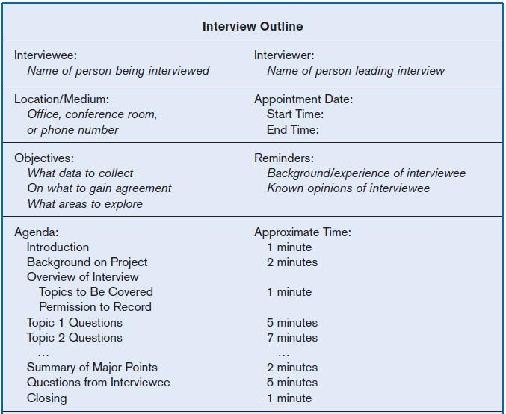
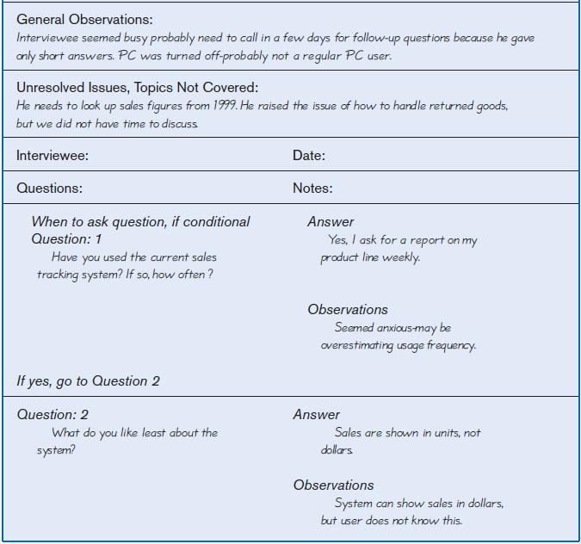
Interviewing and Listening (Cont.)
FIGURE 2 Typical interview guide

Slide 14
Choosing Interview Questions
Each question in an interview guide can include both verbal and non-verbal information.
  Open-ended questions: questions that have no pre-specified answers
  Closed-ended questions: questions that ask those responding to choose from among a set of specified responses

Slide 15
Open ended Questions
Purpose: Used when responses can't be easily predicted or when the exact question is unclear.
Approach: Interviewee is encouraged to speak freely within a broad topic.
Examples:
  “What would you say is the best thing about the current system you use?”
  “List the three most frequently used menu options”
Analyst role:
  React quickly to responses.
  Ask follow-up questions to clarify or expand on answers.
  Observe body language to detect hesitation or incomplete responses.
Advantages:
  May uncover previously unknown or unexpected information.
  Allows deeper exploration of topics.
  Makes interviewees feel more comfortable and in control.
Disadvantages:
  Responses may be time-consuming.
  Difficult to summarize or categorize answers clearly.

Slide 16
Close ended questions
Best used when: Common or expected answers are already known.
Advantages:
  Efficient: Requires less time; more topics can be covered.
  Structured: Easier to organize and compare responses.
  Helpful for starting interviews: Can warm up the interviewee before deeper, open-ended questions.
  Allows observation of non-verbal cues (body language, tone of voice).
  Can include an “Other” option for flexibility in responses.
Disadvantage:
  May miss valuable insights if the respondent feels forced to choose from limited options, rather than giving their true or full answer.

Slide 17
Interview Guidelines for Systems Analysts
Ask Neutral Questions
Avoid phrasing that suggests a “right” answer.
Encourage honest and open responses without bias.
Example to avoid: questions that imply a majority opinion or expected behavior.
Listen Actively
Pay close attention to what is said.
Take thorough notes or record the session (with permission).
Respect the interviewee’s time and follow up if needed.

Slide 18
Interview Guidelines for Systems Analysts (Cont.)
Document Promptly
  Type up notes within 48 hours to retain accuracy.
  Use recordings to verify notes.
  Separate facts from opinions.
  Note down unclear points and verify them later.
  Send notes to interviewee for confirmation.
  Always thank the interviewee — you may need their input again.

Slide 19
Interview Guidelines for Systems Analysts (Cont.)
Avoid Overpromising
  Do not set expectations about system features unless confirmed.
  Explain that the process involves many steps and perspectives.
  Emphasize that all input is valued, but outcomes are not guaranteed yet.
Gather Diverse Perspectives
  Interview various stakeholders:
    End users
    Related system users
    Managers and decision-makers
    IS/IT staff
  Understand different views to support informed and inclusive design decisions.

Slide 20
1.2- Interviewing Groups
Drawbacks to individual interviews:
  Contradictions and inconsistencies between interviewees
  Follow-up discussions are time consuming
  New interviews may reveal new questions that require additional interviews with those interviewed earlier

Slide 21
Interviewing Groups (Cont.)
Interviewing several key people together
  Advantages
    More effective use of time
    Can hear agreements and disagreements at once
    Opportunity for synergies
  Disadvantages
    More difficult to schedule than individual interviews

Slide 22
Nominal Group Technique (NGT)
A facilitated process that supports idea generation by groups
Process
  Members come together as a group, but initially work separately.
  Each person writes ideas.
  Facilitator reads ideas out loud, and they are written on a blackboard or flipchart.

Slide 23
Nominal Group Technique (NGT)
  Group openly discusses the ideas for clarification.
  Ideas are prioritized, combined, selected, reduced.
  NGT exercise used to complement group meetings or as part of JAD effort.

Slide 24
1.3- Directly Observing Users
Direct Observation
  Watching users do their jobs
  Obtaining objective measures of employee interaction with information systems
  Can cause people to change their normal operating behavior
  Time-consuming and limited time to observe

Slide 25
1.4- Analyzing Procedures and Other Documents
Document Analysis
  Review of existing business documents
  Can give a historical and “formal” view of system requirements
  Types of Documents
  Written work procedure
  Business form
  Report
  Description of current information system

Slide 26
Analyzing Procedures and Other Documents (Cont.)
Types of information to be discovered:
  Problems with existing system
  Opportunity to meet new need
  Organizational direction
  Names of key individuals
  Values of organization
  Special information processing circumstances
  Reasons for current system design
  Rules for processing data

Slide 27
Analyzing Procedures and Other Documents (Cont.)
Useful document: Written work procedure
  For an individual or work group
  Describes how a particular job or task is performed
  Includes data and information used and created in the process

Slide 28
Analyzing Procedures and Other Documents (Cont.)
Potential Problems with Procedure Documents:
  May involve duplication of effort.
  May have missing procedures.
  May be out of date.
  May contradict information obtained through interviews.

Slide 29
Analyzing Procedures and Other Documents (Cont.)
Formal Systems: the official way a system works as described in organizational documentation (i.e. work procedure)
Informal Systems: the way a system actually works (i.e. interviews, observations)

Slide 30
Analyzing Procedures and Other Documents (Cont.)
Useful document: Business form
  Used for all types of business functions
  Explicitly indicate what data flow in and out of a system and data necessary for the system to function
  Gives crucial information about the nature of the organization

Slide 31
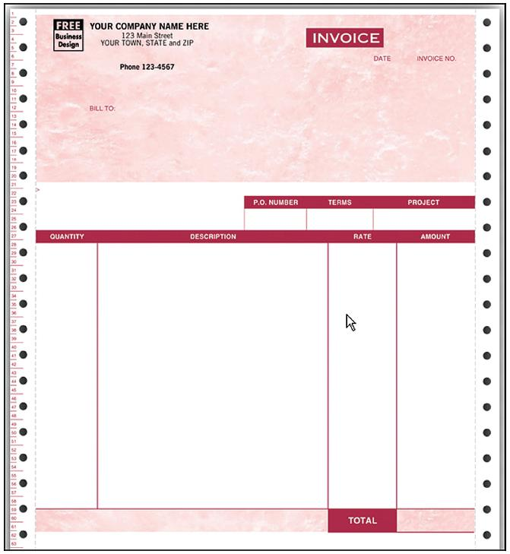
Analyzing Procedures and Other Documents (Cont.)
FIGURE 3
An example of a business form—An invoice form for QuickBooks, from jnk.btobsource.com. Reprinted by permission.
Source: http://jnk.btobsource.com/
NASApp/enduser/products/product_
detail.jsp?pc513050M#

Slide 32
Analyzing Procedures and Other Documents (Cont.)
Useful document: Report
  Primary output of current system
  Enables you to work backwards from the report to the data needed to generate it
Useful document: Description of current information system

Slide 33
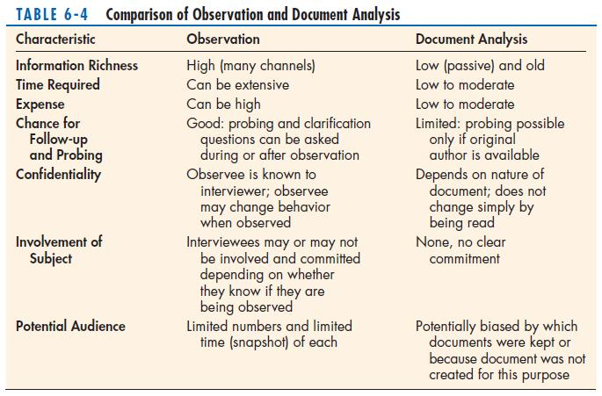
Analyzing Procedures and Other Documents (Cont.)

Slide 34
2- Contemporary Methods for Determining System Requirements
Even though we called interviews, observation, and document analysis traditional methods for determining a system’s requirements, all of these methods are still very much used by analysts to collect important information.
Today, however, there are additional techniques to collect information about the current system, the organizational area requesting the new system, and what the new system should be like.
Several contemporary information-gathering techniques for JAD, CASE tools to support JAD, and prototyping.

Slide 35
2-1 Introduction to Joint Application Design (JAD)
Origin & Adoption
Developed at IBM in the late 1970s
Widely adopted across industries (e.g., insurance in Connecticut)
Core Concept
Brings together key users, managers, and systems analysts
Focuses on collecting system requirements collaboratively
Comparison to Group Interviews
Similar in gathering input from multiple stakeholders
More structured with defined roles and agenda
Allows simultaneous requirement collection from all involved parties
Purpose & Benefits
Identifies both agreements and conflicts early
Promotes clarity, shared understanding, and conflict resolution

Slide 36
JAD Sessions – Structure & Cost Considerations
Session Format
Conducted off-site to minimize distractions
Can last from 4 hours to a full week
May involve multiple sessions
Effectiveness
Encourages deep focus on analysis tasks
Facilitates intense collaboration and informed decision-making
Resource Investment
High cost due to:
  Time of top personnel
  Travel, accommodation, and meals
Justified by the efficiency and quality of outcomes

Slide 37
Key Roles in a JAD Session
JAD Session Leader Trained facilitator, sets agendaRemains neutral, manages discussions, and resolves conflictsDoes not contribute ideas, only guides the process
Users Provide first-hand experience of system usageCrucial for defining real-world requirements
Managers Offer organizational perspectiveHelp align system requirements with strategic goals
Sponsor High-level executive backing the JAD processEnsures resources and authority; may attend opening/closing
Systems Analysts Attend to observe and learnHelp in documenting and clarifying requirements, not leading
Scribe Records discussions, decisions, and diagramsUses word processor or CASE tools
IS Staff Includes programmers, DB analysts, plannersContribute insights on technical feasibility and limitations

Slide 38
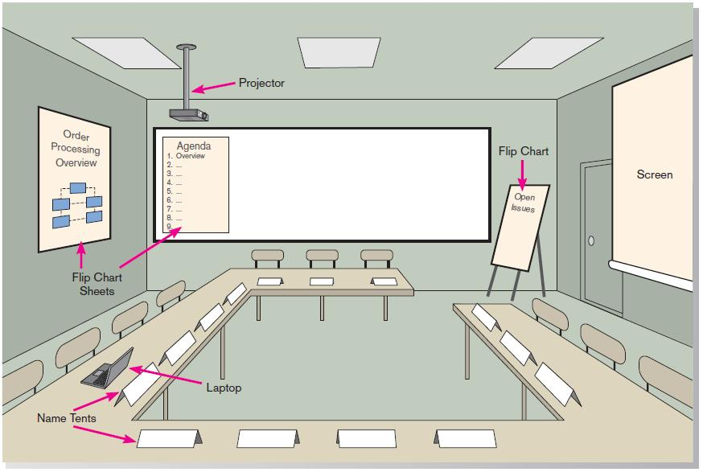
JAD (Cont.)
FIGURE 4 Illustration of the typical room layout for a JAD
Source: Based on Wood and Silver, 1995

Slide 39
CASE Tools During JAD
Enables analysts to enter system models directly into CASE during the JAD session
Screen designs and prototyping can be done during JAD and shown to users

Slide 40
Use of CASE Tools During JAD Sessions
Key Tools: Diagramming, prototyping, form & report generation tools.
Purpose: Support requirements determination, structuring, and alternative evaluation.
Benefits:
  Visualize and refine system requirements with users.
  Improve consistency, completeness, and correctness.
  Speed up transition between analysis phases.
  Enable real-time model building and feedback.
Advocated Practice: Running CASE tools during JAD enhances collaboration and captures requirements more accurately than manual notes.

Slide 41
2.2- Using Prototyping During Requirements Determination
Quickly converts requirements to working version of system
Once the user sees requirements converted to system, will ask for modifications or will generate additional requests

Slide 42
Using Prototyping During Requirements Determination (Cont.)
Most useful when:
  User requests are not clear.
  Few users are involved in the system.
  Designs are complex and require concrete form.
  There is a history of communication problems between analysts and users.
  Tools are readily available to build prototype.

Slide 43
Using Prototyping During Requirements Determination (Cont.)
Drawbacks
  Tendency to avoid formal documentation
  Difficult to adapt to more general user audience
  Sharing data with other systems is often not considered
  Systems Development Life Cycle (SDLC) checks are often bypassed

Slide 44
3- Radical Methods for Determining System Requirements
Business Process Reengineering (BPR):
search for and implementation of radical change in business processes to achieve breakthrough improvements in products and services

Slide 45
Radical Methods for Determining System Requirements (Cont.)
Goals
  Reorganize complete flow of data in major sections of an organization.
  Eliminate unnecessary steps.
  Combine steps.
  Become more responsive to future change.

Slide 46
Identifying Processes to Reengineer
  Key business processes
    Structured, measured set of activities designed to produce specific output for a particular customer or market
    Focused on customers and outcome
    Same techniques are used as for requirements determination

Slide 47
Disruptive Technologies
Information technologies must be applied to radically improve business processes.
Disruptive technologies are technologies that enable the breaking of long-held business rules that inhibit organizations from making radical business changes.

Slide 48
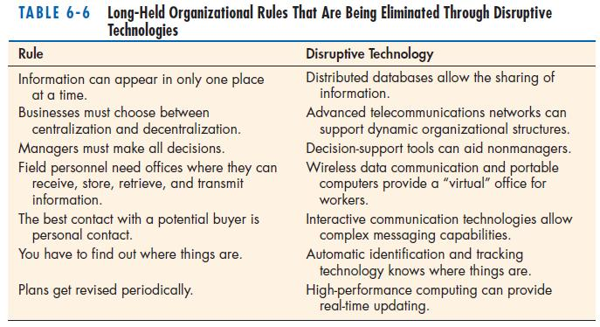
Disruptive Technologies (Cont.)

Slide 49
4-Requirements Determination using Agile Methodologies
Continual user involvement
  Replace traditional SDLC waterfall with iterative analyze – design – code – test cycle
Agile usage-centered design
  Focuses on user goals, roles, and tasks
The Planning Game
  Based on eXtreme programming
  Exploration, steering, commitment

Slide 50
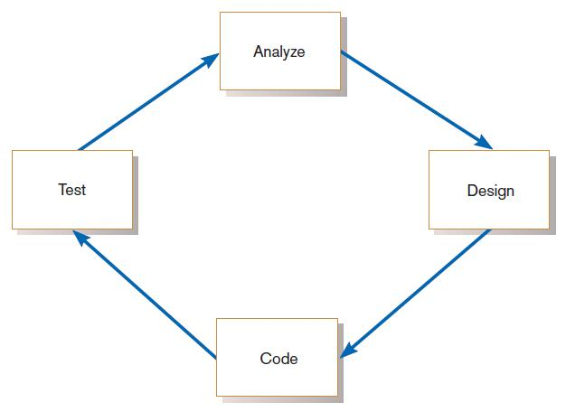
Continual User Involvement
FIGURE 5
The iterative analysis–design–code–test cycle

Slide 51
Agile Usage-Centered Design Steps
Gather group of programmers, analysts, users, testers, facilitator.
Document complaints of current system.
Determine important user roles.
Determine, prioritize, and describe tasks for each user role.
Group similar tasks into interaction contexts.
Associate each interaction context with a user interface for the system, and prototype the interaction context.
Step through and modify the prototype.

Slide 52
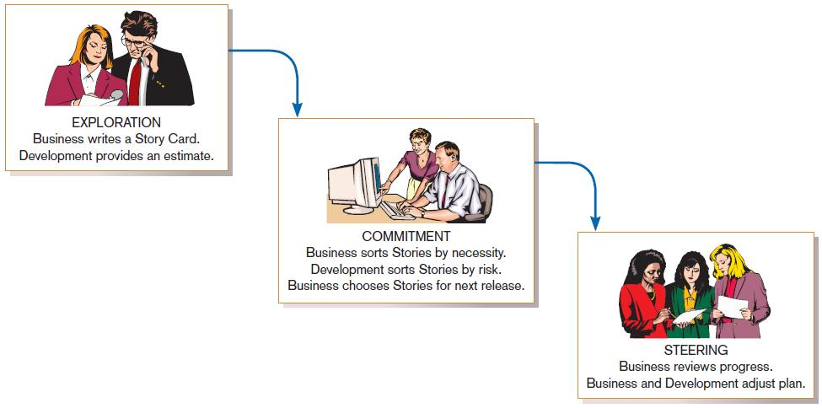
The Planning Game from eXtreme Programming
FIGURE 3
eXtreme Programming’s Planning Game

Slide 53
Modern Systems Analysis and Design by
Jeffrey A. Hoffer
Joey F. George
Joseph S. Valacich

